Slide 1

Deploying Containerized Applications (Azure)
Brian C Harrison (TheProfessorCloud)
Cloud Solution Architect

Slide 2
Assumptions & Resources
Familiar with Containers and Specifically Docker Concepts
Familiar with DevOps Concepts and Specifically Pipelines
Familiar with Infrastructure as Code concepts and Cloud-based deployment methods
Familiar with Azure, Github and DevOps tools
Github: https://github.com/brharr/container-apps-in-cloud
Slide Deck(s)
Code for Application and Scripts
Cloud Templates

Slide 3
IMPORTANT!!!
This is not an exhaustive discussion of:
Every feature for specific Cloud-based Container Services
DevOps tools to use with Containerized Applications
Every possible DevOps process that could be implemented for Containerized Applications
This is a deep discussion of the different services and why you might want to use each one
This is a deep discussion of how to deploy containerized applications to Cloud-based services and how they are configured

Slide 4
USE CASE
You have been given the code for a simple NodeJS web application that your company is using for its customers and is deploying once per customer. Up until now, they have been deploying said code in standard VMs On-Prem. However, they would now like to start the modernization process of this code and they would like to start by containerizing the application and deciding what the best Cloud-based services are for managing and maintaining this new Deployment model. Here are you Tasks:
1.) Create container Images for Each Tier of the Application and Test
2.) Create Deployment Pipelines using different methods and deploy to your Cloud-based Container Registry
3.) Deploy Application from Registry to Cloud-based Container Services
4.) Test out each Deployable Container Service within Azure

Slide 5
Agenda
Introduction
Create Pipelines to push Container Images to a Registry
Azure DevOps
GitHub Actions
Pushing Container Images to Azure native services
Configure Azure native services for real-world production deployments

Slide 6
Container Based Services
Azure Container Registry
Azure Container Instances
Azure App Services for Containers
Azure Kubernetes Services

Slide 7
Containerize your Application & push to ACR

Slide 8
Intro to Base Code and Cloud Shell
Azure DevOps Pipelines to ACR
Manual Dockerfile push to ACR
Intro to Azure Container Registry
GitHub Actions to ACR
Agenda

Slide 9
Responsibility
Intro to Base Code and Cloud Shell
Azure DevOps Pipelines to ACR
Manual Dockerfile push to ACR
Intro to Azure Container Registry
GitHub Actions to ACR
Agenda
Software Engineer
DevOps Engineer

Slide 10
Deploy to Azure Container Instances (ACI)

Slide 11
Agenda
Intro to Base Code for Application and Cloud Shell
Deploy ARM Template for Build VM
Create Azure DevOps Repos
Walk-through and Edit Dockerfile
Containerize Web & API Tier
Test Containerized Application Locally

Slide 12
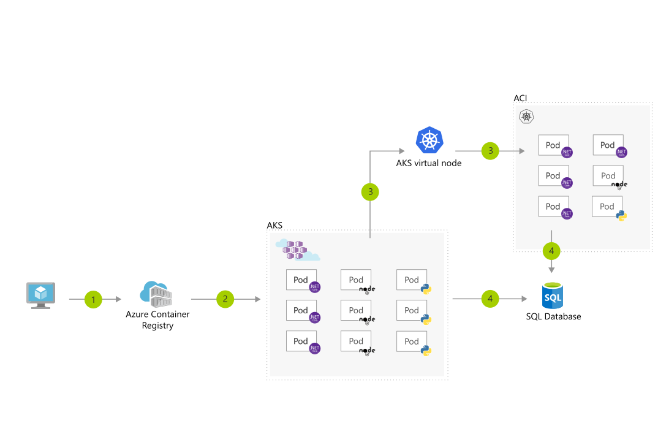
Virtual Nodes with ACI

Slide 13
Deploy to Azure App Services for Containers

Slide 14
Agenda
Create Web/API App Services
Walkthrough Deployment Wizard (Single Container)
Configure App Services (Environment Variables)
Walkthrough Deployment Wizard (Lifecycle Script)
Containerize Web & API Tier
Test Containerized Application Locally

Slide 15
Deploy to Azure Kubernetes Service (AKS)

Slide 16
Agenda
Create Web/API App Services
Deploy ARM Template for Build VM
Create Azure DevOps Repos
Walk-through and Edit Dockerfile
Containerize Web & API Tier
Test Containerized Application Locally

Slide 17
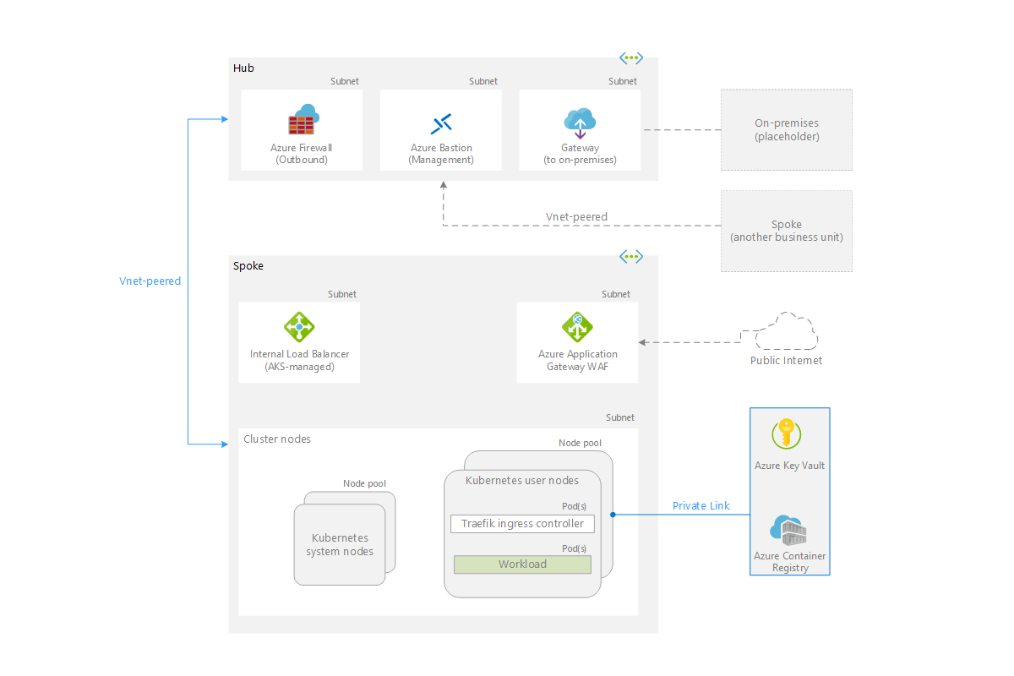
Base AKS Architecture

Slide 18
Wrap-Up

Slide 19
Why so many Options?
JUST USE KUBERNETES
Development / Testing Cycles
Complexity of Application
Complexity of Deployment
Complexity of Long-Term Administration and Operational Management

